Slide 1
In the loop
Henri Williams, Dom Goodwin, Ben Farley
Article summarization and question answering

Slide 2




Built with
Tensorflow
Pytorch
Google’s BERT
Cutting edge Natural Language Processing AI

Slide 3

Training the model
Finetuning of BERT Base model
Trained on a v3-8 TPU
64GB of memory
SQuAD 2.0 dataset
Took < 1hour

Slide 4

Example summary
Britain’s first retirement homes for LGBT OAPs
https://www.economist.com/britain/2019/06/22/britains-first-retirement-homes-for-lgbt-oaps
the organisation, founded in 2014 , is hoping to find a site within a year for what would be britains first retirement home for lgbt people
the difference is that most of the residents of tonics proposed development would be lesbian , gay , bisexual or transgender .
another group , london older lesbians co-housing ( lolc ) , is also on the lookout for a site in the capital .

Slide 5

Example summary
some of the states other standards for reducing greenhouse-gas emissions contribute to higher housing costs.
meanwhile , residential and industrial electricity rates in california are 50 % and 75 % more than the national average.
its high standards for energy efficiency , for example , have helped to bring more fuel-efficient cars and fewer carbon-intensive products to the rest of the country.
California is a leader on environmentalism
https://www.economist.com/special-report/2019/06/22/california-is-a-leader-on-environmentalism

Slide 6
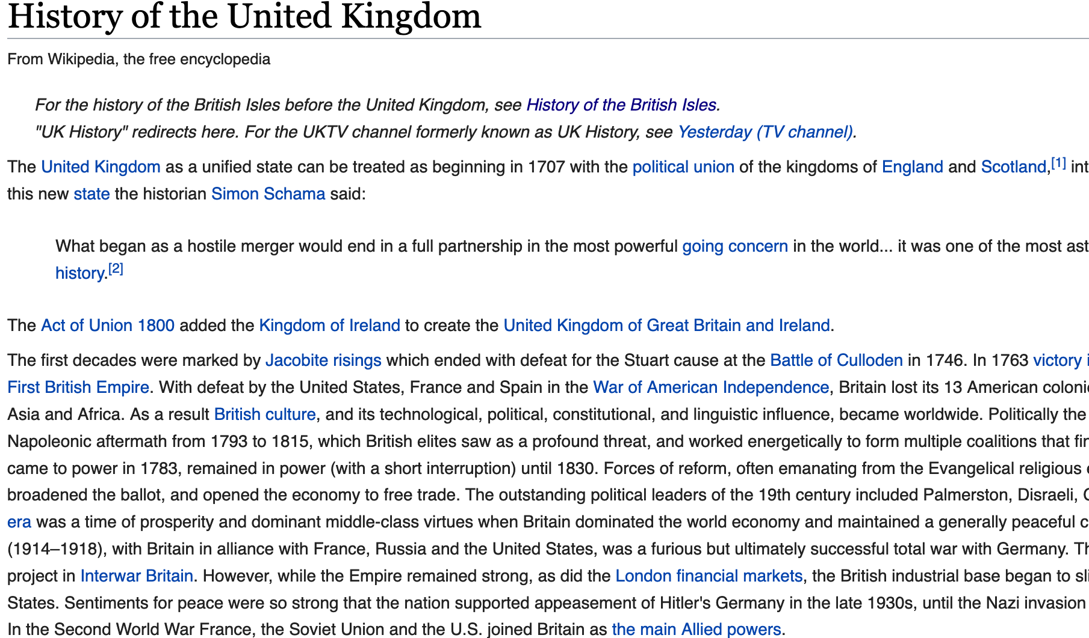
Example q+A
When was the welfare state expanded?
1919 and 1920
Who won the election in 1997?
Tony Blair
What was the result of the Scottish referendum?
Scotland voting by 55% to 45% to remain part of the United Kingdom
Wikipedia: History of the UK
https://en.wikipedia.org/wiki/History_of_the_United_Kingdom

Slide 7
Further reading
https://rajpurkar.github.io/SQuAD-explorer/
https://github.com/google-research/bert

